Slide 1
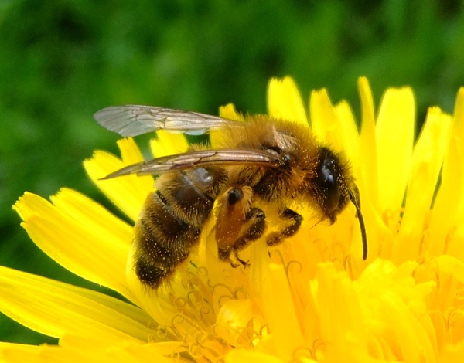
The Academies of J.J. Daniell M.S. Winter Parent Meeting for Rising 8th Grade
February 13, 2024
6:30 PM

Slide 2
The Academies of J.J. Daniell M.S.
SPANISH
Mrs. Alarcon
STEAM
Mrs. West
Ms. Light
Leadership, Law & Public Service
Mr. Johnson
Academy Director: Mrs. Foxwell Marianna.Foxwell@cobbk12.org
Publicity: Mr. Wagner Grant.Wagner@cobbk12.org

Slide 3
Welcome to the SteAm academy
Facilitator: Mrs. Natalie West
Email: Natalie.West@cobbk12.org

Slide 4
Curriculum Topics for STEAM Academy Class
1st Semester Capstone
Science Fair Project
or
Tech Fair Project
or
FLL Robotics Competition (FIRST LEGO League Challenge)
Scientific Research
Writing Skills
Experimentation or Creation
Presentation/Public Speaking Skills
2nd Semester Capstone
You be the Chemist National Challenge
Students work in teams of 3-4
Chemistry Quiz Bowl
Research the challenge topic
Identify a problem in the community related to the challenge topic and develop a solution.
Create a video that communicates the new and innovation solution to the problem.
National Middle School Physics Olympiad
Student competition that gives students a chance to showcase their physics and science skills.
Problem Based Units (PBLs)
When students are
not working on the Capstone Projects, they will investigate and solve real-world problems through immersive and problem-based units
of instruction.

Slide 5
STEAM Academy Additional Information
Additional Requirements
H.S. Physical Science and/or H.S. Algebra I
Community Involvement
Volunteering: 20 hours per school-year
School Functions (Spooky STEM Night, Feeder Schools STEM Night, JJ Day Concession Stands, or Hosting other events at Daniell
Can also be completed outside of school
Ex. Church, Social or Civic Groups, Shelters, Daycares, or Small/Family businesses
Previous Field Trips & Activities:
STEM Under the Stars Movie Night, Spooky STEM Night, Sparkles Skating Rink, iFly, Piedmont Park Conservancy, Medieval Times Dinner Theater, Garner-Holt Production Studio Virtual, PPE Making for Atlanta Beats COVID, and NASCAR Virtual Field Trip

Slide 6
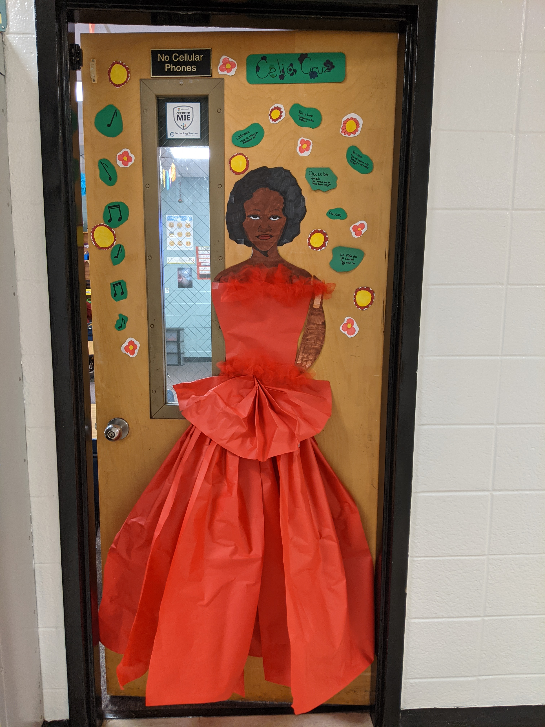
Bienvenidos
Facilitators: Sra. Alarcon
Contact information
Email: Karina.alarcon@cobbk12.org

Slide 7
Más Información
Capstone Projects
Pulsera project
Hispanic Heritage month
Portfolio on 21 Spanish-Speaking countries
Project based on Hispanic needs in the community
Previous Field Trips & Activities:
Georgia Tech History of Dance
Spooky STEM Night Volunteers
Spanish Art bus
NASA speaker: José M. Hernández B
Plaza Fiesta Spanish Scavenger Hunt

Slide 8
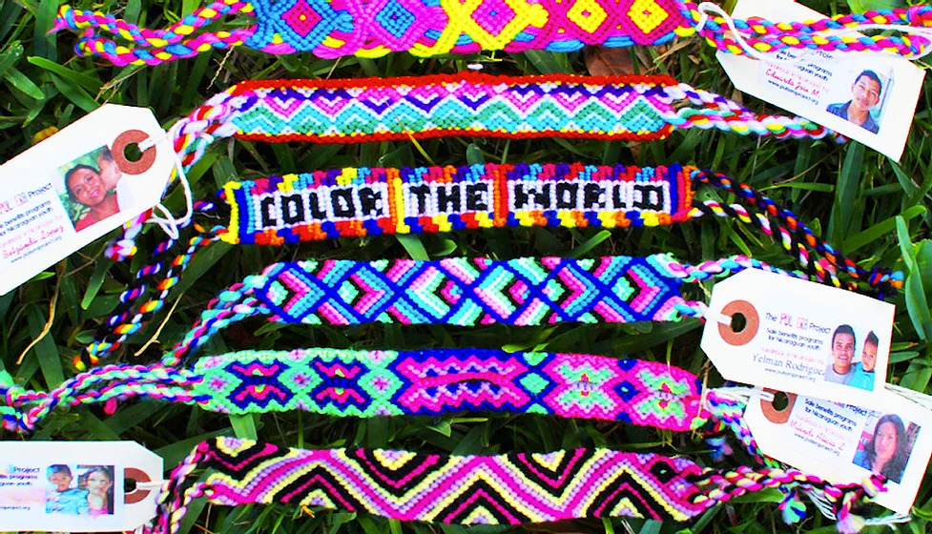
Hispanic Heritage Month
September 15 – October 15
Pulsera project
The Pulsera Project is a nonprofit organization that educates, empowers, and connects Central American artists with students in more than 3,000 U.S. schools through the sale of colorful handwoven bracelets, or "pulseras"
https://www.pulseraproject.org/
https://www.pulseraproject.org/videos

Slide 9
HS Credit Course:
Local Area Studies
Counts toward the Civics Diploma Seal at any GA HS
Email: Jordan.johnson@cobbk12.org
Leadership & Law Academy

Slide 10
Capstone Projects for Leadership & Law Academy Class
1st Semester Capstone
Project Soapbox Speech
Or
Social Studies Fair Project
Speech to answer the question, “What is the most important issue facing your community?
Students will learn how to develop and deliver this speech and then present their speeches to judges
2nd Semester Capstone
Culminating Leadership Project
Students will develop their own criterion for what constitutes “great leadership.” and defend their ideas in one of the following ways.
Formal Essay
Edited Video
Speech
Other Multi-media Product
Areas of Focus
Leadership
Public Speaking
Action Civics
Law
Constitution

Slide 11
Activities / Lesson Topics
Public Communication
Toastmaster games
Improv exercises
Soapbox Speech
Dressing for success
Leadership Speakers
Business
Military
Judicial/Legal
Political
Civil Service
Charity/NGO
Civics / Government / Law
Researching issue of interest in community & nation
U.S. Constitution
Understanding how democracy works in United States
Federalism
Local & State government
Previous Field Trips & Activities
Soapbox Symposium (January, April)
Civil Rights Museum
Georgia State House
weekly (business casual);
monthly (business formal)
Spooky STEM Night Volunteers

Slide 12
Leadership & Law Academy Class
Volunteering:
• 20 hours per school year
Previous Field Trips & Activities:
• Civil Rights Museum
• Georgia State House
• Spooky STEM Night Volunteers
M.S. Syllabus

Slide 13
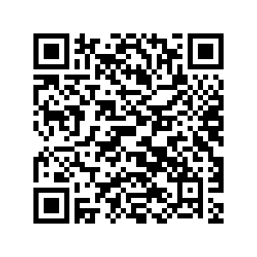
Important Dates to Remember
Friday, 02/16/24, Applications Will Go Live On the Website
https://www.cobbk12.org/daniell/page/4324/j-j-daniell-advanced-learning-academies

Slide 14
Important Dates to Remember
Applications Will Close on 3/15/24 at 4:00 PM – No late applications will be considered for the academies, and all forms must be in by this date. All Flipgrid submissions must be completed by this date as well. The link to the Flipgrid will be posted with the application.
Updates to the web page will reflect due dates and all links by 2/16/24.

Slide 15
Q & A

