Slide 1
Campbell Middle School Improvement Title 1 Meeting March 27, 2023
AGENDA
What is Title I
ESEA Parents Right-to-Know
Parental Involvement
Usage of Title I Funds
Highlights for 2023-2024 Title 1 School Improvement Plan for Campbell MS
Dr. Camille Havis
Principal
Ms. Dalia Saldierna
Parent Facilitator

Slide 2
AGENDA ITEM #1
Title I, Part A falls under the Elementary and Secondary Education Act or ESEA.
The program makes it possible to provide additional interventions that support struggling learners.
Money received is based on having more than 55% of students qualify for free or reduced lunch.
What is Title 1

Slide 3
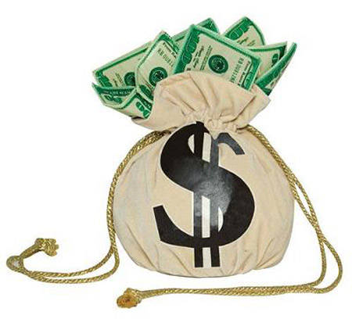
AGENDA ITEM #2
ESEA directs schools to notify parents about plans for next school year with Title 1 Funding
1. The breakdown of the budget
2. The staff we will employ
3. Other plans for money being spent
ESEA Parents Right-to-Know

Slide 4
AGENDA ITEM #3
Parental involvement in the process
This is your part in the process by viewing the presentation.
This presentation will be on the website
You can comment via the survey
Parental Involvement

Slide 5
AGENDA ITEM #4
The CMS Title 1 Personnel Budget:
1 Full Time Parent Facilitator
1 ELA Teacher
1 Math Teacher
= 80% of the Budget
Professional Learning Budget
Per Title 1, schools are required to do professional training for teachers. Our training includes:
Conferences for IB Reauthorization
Conferences to begin year 1 of STEAM certification
Supplies
The PBIS Rewards App
Subscription to IXL (ELA, MA, SCI, SS)
Our CMS Student Agendas
Supplies for School
Things like copy paper, printer ink, etc. will be purchased
Usage of
Title 1 Money
(Precents of the potential budget)

Slide 6
AGENDA ITEM #5
GOAL #1
Increase the number of students moving up one level on the Reading Inventory for grades 6-8 by 500 students.
Schoolwide writing strategy (RACE)
EOG GA Milestones Writing Practice
Thursday Campbell Collaborative Communities
Common Unit Plans & Assessments with a writing component on each summative.
GOALS for
TITLE 1

Slide 7
AGENDA ITEM #6
GOAL #2
Increase the number of students moving up one level on the Math Inventory for grades 6-8 by 500 students.
Schoolwide writing strategy (CUBES)
EOG GA Milestones Word Problems Practice
Thursday Campbell Collaborative Communities
Common Unit Plans & Assessments with a math writing component on each summative.
GOALS for
TITLE 1

Slide 8
AGENDA ITEM #7
GOAL #3
Decrease the number of student offenses and incidents for grades 6-8 by 50.
PBIS App will allow students to track points earned
PBIS App will allow students to track infractions
Tuesday grade level meetings to discuss interventions
Restorative conferences and circles to decrease incidents among students having conflict
Weekly Advisement lessons including the IB learner profile for character
Weekly Advisement lessons including the PBIS APP and being respectful, responsible and safe.
GOALS for
TITLE 1

Slide 9
AGENDA ITEM #8
Do you understand how a school qualifies for Title 1 money?
Do you understand the percentage appropriations for the budget?
Do you agree with the employing 2 additional teachers and a parent facilitator as part of the personnel budget?
Do you understand the goal for ELA?
Do you understand the goal for MATH?
Do you understand the goal for Behavior?
Would you be willing to serve on the Title I Principal's Advisory Committee next year?
Title 1
Survey Items

Slide 10
Your Input is Needed
Please provide feedback
You can go to the survey online
https://forms.office.com/r/GUBhniCeBX
The Title 1 School Improvement Recommendation

