Slide 1
Campbell High School Track and Field 2026 Season
Student-Athlete Informational Meeting

Slide 2
Our Coaches
We have seven different event groups – sprints, hurdles, throws, high jump, long jump, relay team, and distance.
Girls Head Coach – Coach Barnes
  Boys Head Coach – Coach Phillips
Coach Newton
Coach Ruff
Coach Jones
Coach Smith

Slide 3
CHS Athletic Clearance
A new registration in the Athletic Registration portal is required each school year.
  Your parent must complete this step
Physical Examinations: Must be dated after April 01, 2025
  Must be uploaded before conditioning begins

Slide 4
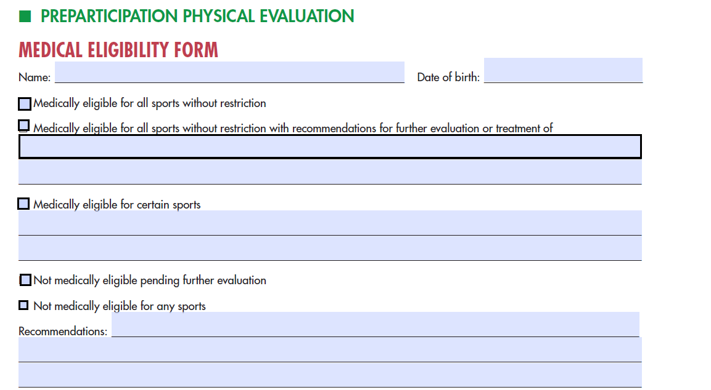
Physical Examination

Slide 5
CHS Athletic Clearance
Other forms: Located in the Athletic Registration Portal
  Medical Eligibility Form
  Cardiac Awareness Form
  Concussion Awareness From

Slide 6
Other Sports
Athletes participating in winter CHS sports should prioritize their winter sport over track and field until that season is over.
Once the winter sport season ends, athletes should prioritize track and field over other CHS sports.

Slide 7
Preseason Conditioning
Monday, Tuesday, Thursday 4-5:30pm at the CHS track.
This is a critical part of the season/training!
Starts Monday, November 10th

Slide 8
Q & A

