Slide 1


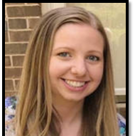
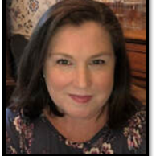

Ali
Brisse
Kelley
Davis
Jamie
Roach

Slide 2


Gifted Eligibility Process and Service Models

Slide 3
Referrals
Automatic
  System-wide assessment – Grades K, 1, 3, 5, 7, 8
  Permission sent based on review of scores
  CogAT, IOWA, additional achievement (K)
Reported
  GF1
  Parents, teachers, self
  Do not always equate to evaluation – LEC and CEC base decisions on all available data
Reciprocity
  In state only
Notes:
Automatic Referrals:
Currently grades 1, 3, 5, and 7 go through the automatic referral process due to system-wide testing
The CogAT is administered in grades 1, 3, and 7
The IOWA is administered in grades 3, 5, and 7
Remind parents all scores are valid for two years
Reported Referrals:
Can be made by any person with knowledge of a student’s abilities. Reported Referrals are required for any student from out of state who wants to be considered for gifted eligibility in the state of GA.
Reported referrals require the completion of GF 157 by referring individual.
Making a referral does not necessarily mean that a child will be tested further. All existing data is reviewed. If further testing is warranted, permission to test a student will be obtained in writing.
Reciprocity
In state - Any student who meets the Georgia eligibility criteria is considered eligible to receive gifted education service in Cobb County upon verification of records. The student transferring into the district must meet the Cobb’s criteria for continuation of gifted services.

Slide 4
State Rule
Two Options for Eligibility
Option A/Psychometric: A student must meet eligibility requirements in both Mental Abilities and Achievement.
Option B/ Multiple Criteria: A student must meet eligibility requirements in three of the four following areas: Mental Abilities, Achievement, Creativity, and Motivation.

Slide 5
Determination of Eligibility
Option A/Psychometric: A student must meet eligibility requirements in both areas:
Mental Ability
  Standardized test, composite score only
  K-2 – 99th percentile
  3-12 – 96th percentile
Achievement
  Standardized test, total battery, total reading, or total math
  K-12 – 90th percentile
Notes:
MA– we use age percentiles
A – we use grade percentiles

Slide 6
Determination of Eligibility
Option B/ Multiple Criteria: A student must meet eligibility requirements in three of the four following areas:
Mental Ability
Achievement
Creativity
Motivation
Notes:
While assessments vary, the scores needed are consistent K-12.

Slide 7
Determination of Eligibility: Multiple Criteria
Mental Ability: Standardized test, component or composite score, 96th percentile (K-12)
Achievement: Standardized test, total battery, total reading, or total math, 90th percentile (K-12)
Creativity
  90th percentile on a creativity rating scale OR
  90th percentile on a creativity assessment (administered grades 1-12 only, including as follow-up administered as needed for K students occurring in first grade)
Motivation
  90th percentile on a motivation rating scale OR
  90 percent on a motivation assessment (1-8) OR
  Qualifying GPA (7-12)
Nationally-normed test must be used for at least one assessment category
Rating scale may be used to establish eligibility in only one assessment category
Notes:
Inform parents that two rating scales cannot be used to determine gifted eligibility, AND that scores from system-wide testing are valid for two years.

Slide 8
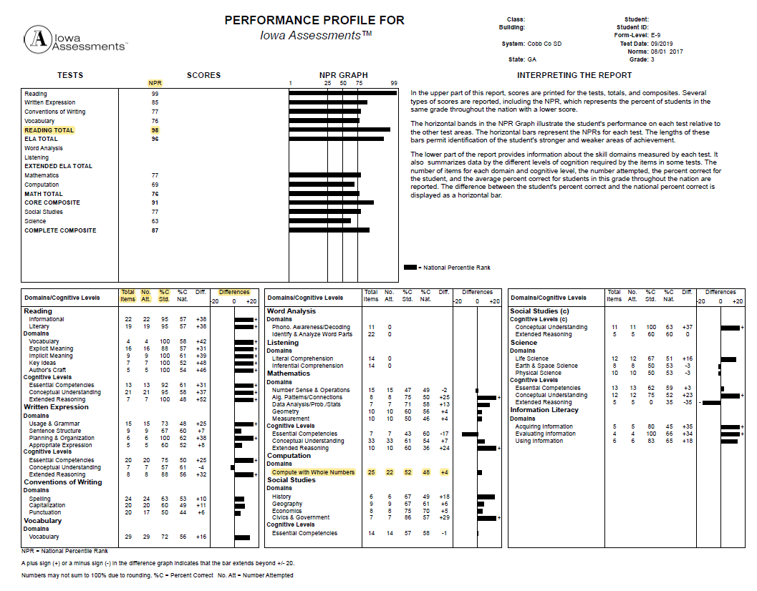
Sample Score Report
Notes:
We use the age percentile scores on the mental ability assessment and grade percentile scores on the achievement – determined by the state.
Briefly review important terms from the testing glossary: difference btw percentile (norms) and percentage: percentile is a score that compares a child to a group (norming process) and percentage is a score based on proportion of correctly answered items on an assessment, review additional information report provides, such as #attempted/total # of items, looking at strengths through the bar graph, etc.

Slide 9
Assessments Used
Mental Ability
Cognitive Abilities Test (CogAT)
Naglieri Nonverbal Ability Test (NNAT)
Achievement
IOWA
Creativity
Gifted Rating Scale (GRS & GRS-P)
Motivation
Torrance Test of Creative Thinking (TTCT)
Gifted Rating Scale (GRS & GRS-P)
Motivation Portfolio (1-5)
GPA (7-12)
Notes:
The state has a wider menu of assessment options that can be utilized, HOWEVER, it is a menu for local school systems, not parents. We can not feasibly provide every assessment option for each category.

Slide 10
GRS Rating Scale
Nationally normed
All teachers trained on identifying behaviors specific to gifted children
Based on observable behaviors in general education classroom over period of minimum of 6 weeks
Measures multiple subscales, including creativity and motivation
Notes:
If you are questioned about the SUBJECTIVITY of teachers when completing these rating scales, remind parents of the training teachers receive and about their ability to apply professional judgment in rating a student’s behavioral characteristics. These judgments are based on observed behaviors in the classroom.

Slide 11

Testing Window
1st & 3rd – CogAT – Sept. 9 – 11
3rd & 5th – IOWA – Sept. 16 – 19
Gifted Eligibility testing begins in November runs through December.
Typically, a couple of weeks after system-wide testing data is received
K students - Spring
Gifted eligibility evaluation may be considered in all grade levels as a reported or automatic referral
Notes:
Every attempt is made to complete gifted eligibility evaluation before the winter break. However, there are circumstances that cause testing to carry over to the new year.

Slide 12
Gifted Delivery Models
Resource
  Gifted education specialist
  Interdisciplinary curriculum based on cognitive and affective growth
Cluster Grouping
  Grouped with peers in general education classroom
  Gifted endorsed classroom teacher
Collaborative Teaching
  General education teacher with gifted education specialist
  Differentiated lessons for gifted students
Advanced Content
  Grades 4-12, core content areas
  Specified criteria – does not need to be gifted eligible
Advanced Placement and IB (International Baccalaureate)
Notes:
A student does not need to be identified gifted to be eligible for advanced content classes.

Slide 13
Questions?

